Slide 1
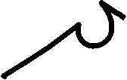










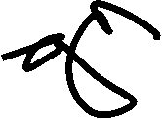





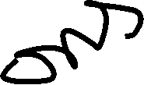

Lecture No 06

Slide 2
































































Slide 3





























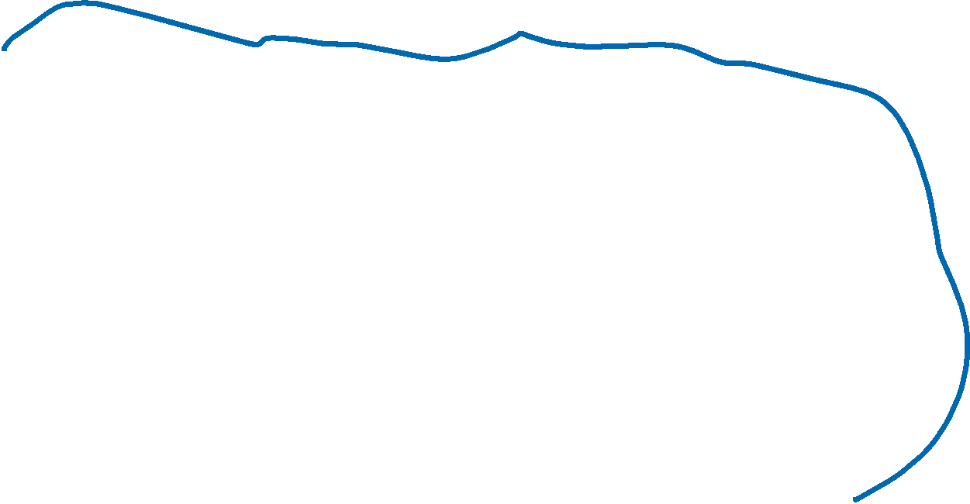








Slide 4

































Slide 5





























































Slide 6































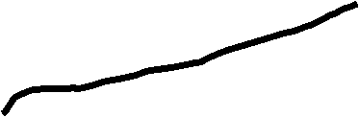













Slide 7










































Slide 8



















































Slide 9

















































Slide 10









































Slide 11







































Slide 12

















































Slide 13

































Slide 14
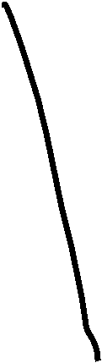



























Slide 15
















































Slide 16


















































Slide 17


















































Slide 18












































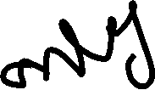
















Slide 19































































Slide 20































Slide 21






















































